Slide 1
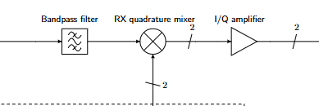
Subsystem A: RX Bandpass Filter, Limiter, and Quadrature Mixer
Team 10: Ryan, Michael, and Harish

Slide 2
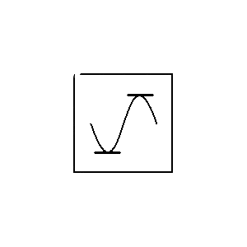

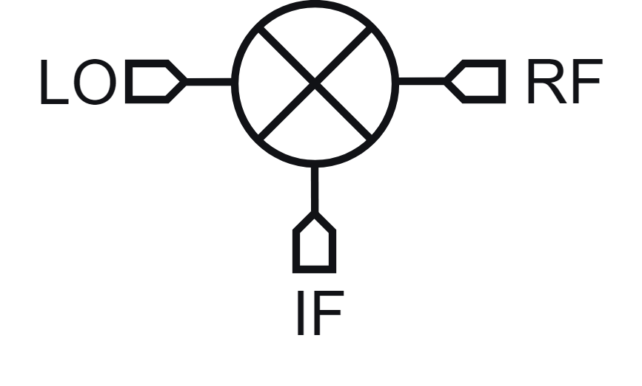
The role of Subsystem A is to prepare a signal for demodulation.
RX Bandpass Filter
Quadrature Mixer
Reduces the incoming signal to a specified bandwidth.
Converts signal to a lower frequency
Limiter
Protects circuit components from high amplitude signals.
Presenter: Harish B

Slide 3
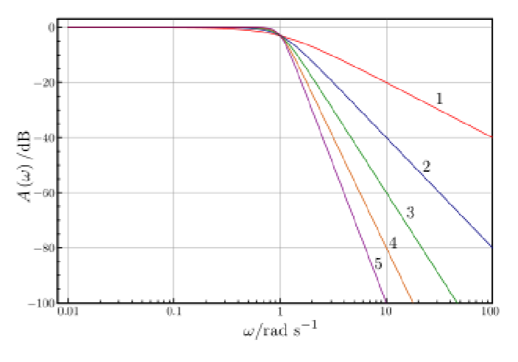
Our design aims to be simple whilst meeting constraints.
Using minimal circuit components reduces potential points of error.
The deadline is more achievable by utilizing a more simple design.
The degree of filtering will be the minimum while still meeting constraints.
Presenter: Michael Z

Slide 4
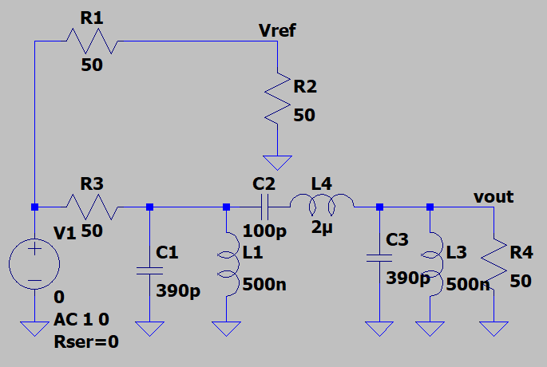
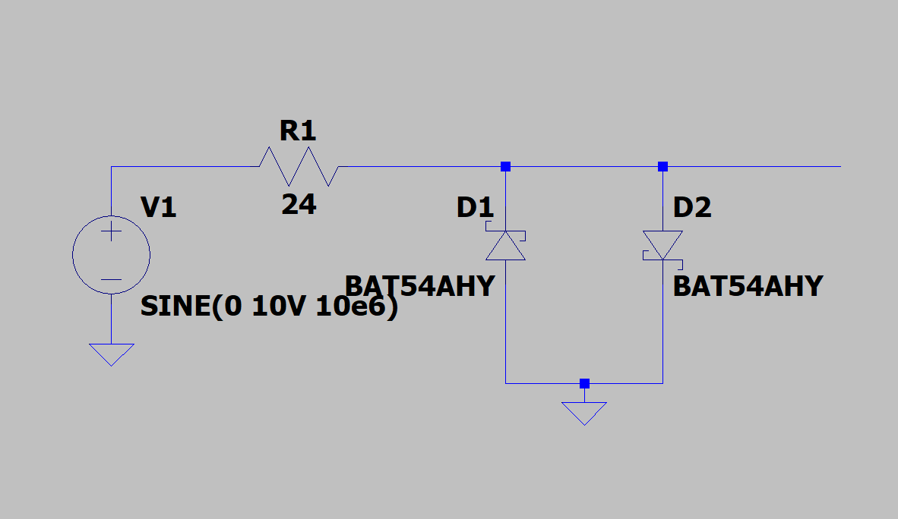
The RX filter and limiter is implemented with reactive components and diodes.
Implemented the BAT54S diode due to high frequency compatibility and accurate forward voltage.
RX Filter used inductors and capacitors to build a 3rd order configuration.
Presenter: Ryan N

Slide 5
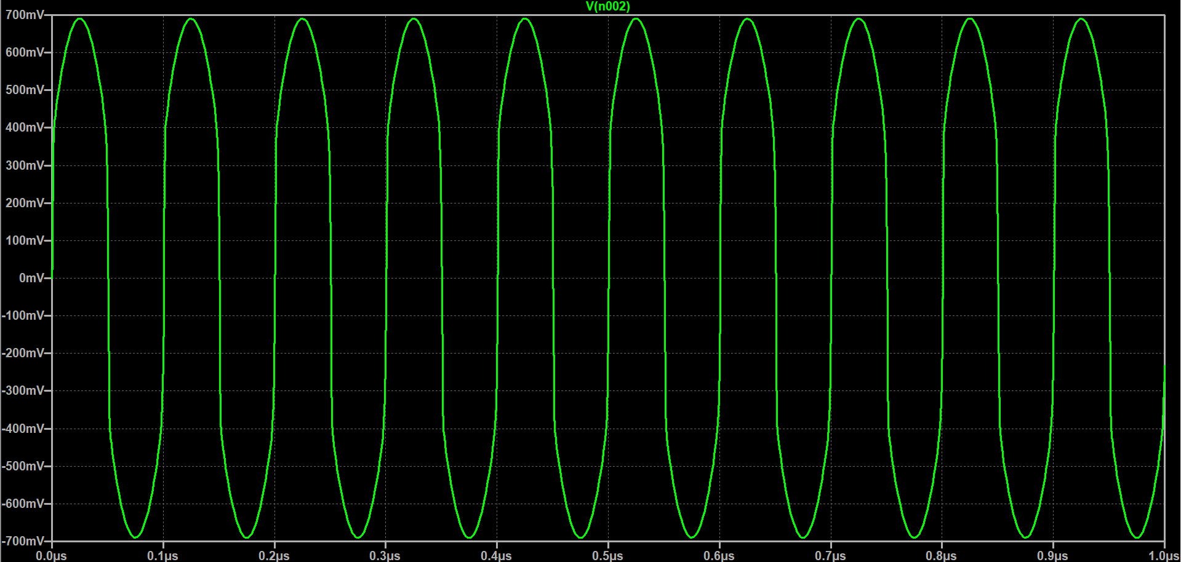
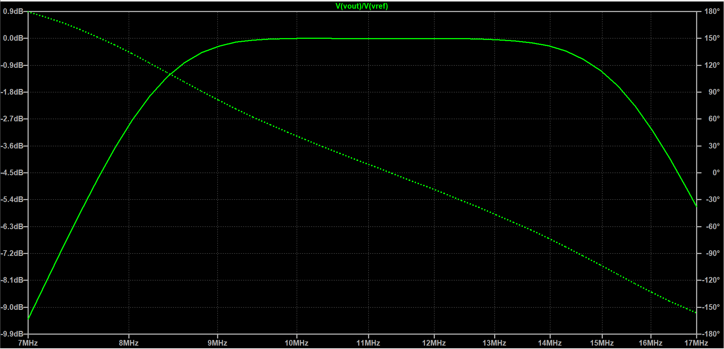
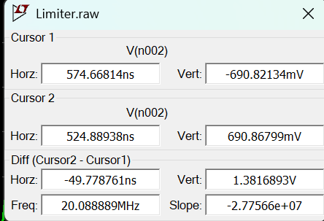
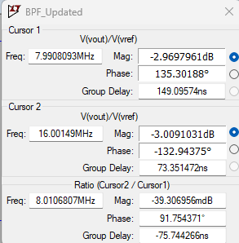
Through simulation, the design was confirmed to meet the minimum constraints.
System | Constraint(s)
Limiter | - Maximum of ± 0.7 V is passed, any excess is clipped
RX Bandpass Filter | - Must pass 8-16 MHz frequency bandwidth - 3 dB cutoff frequencies must be at 8 and 16 MHz
Quadrature Mixer | - I and Q signals must be 90°±12.5° apart in phase, with Q lagging I - Amplitude difference must be within 1 dB - Outputs must not exceed 0 - 5 V
I/Q Amplifier | - Minimum of 30 dB gain applied to the I and Q signals
Low-pass Filter | - At least first order filtering with an upper cutoff frequency of 96 kHz
Presenter: Ryan N

Slide 6
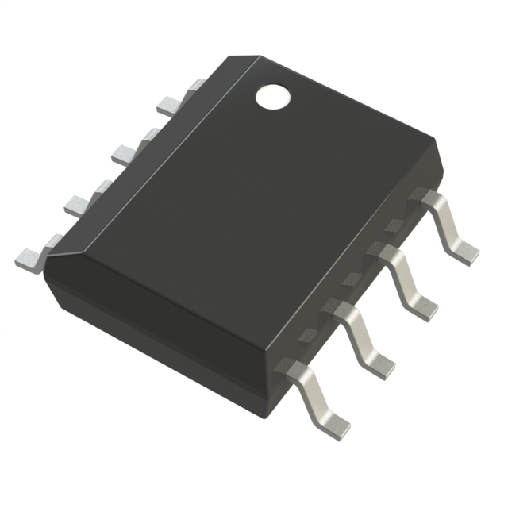
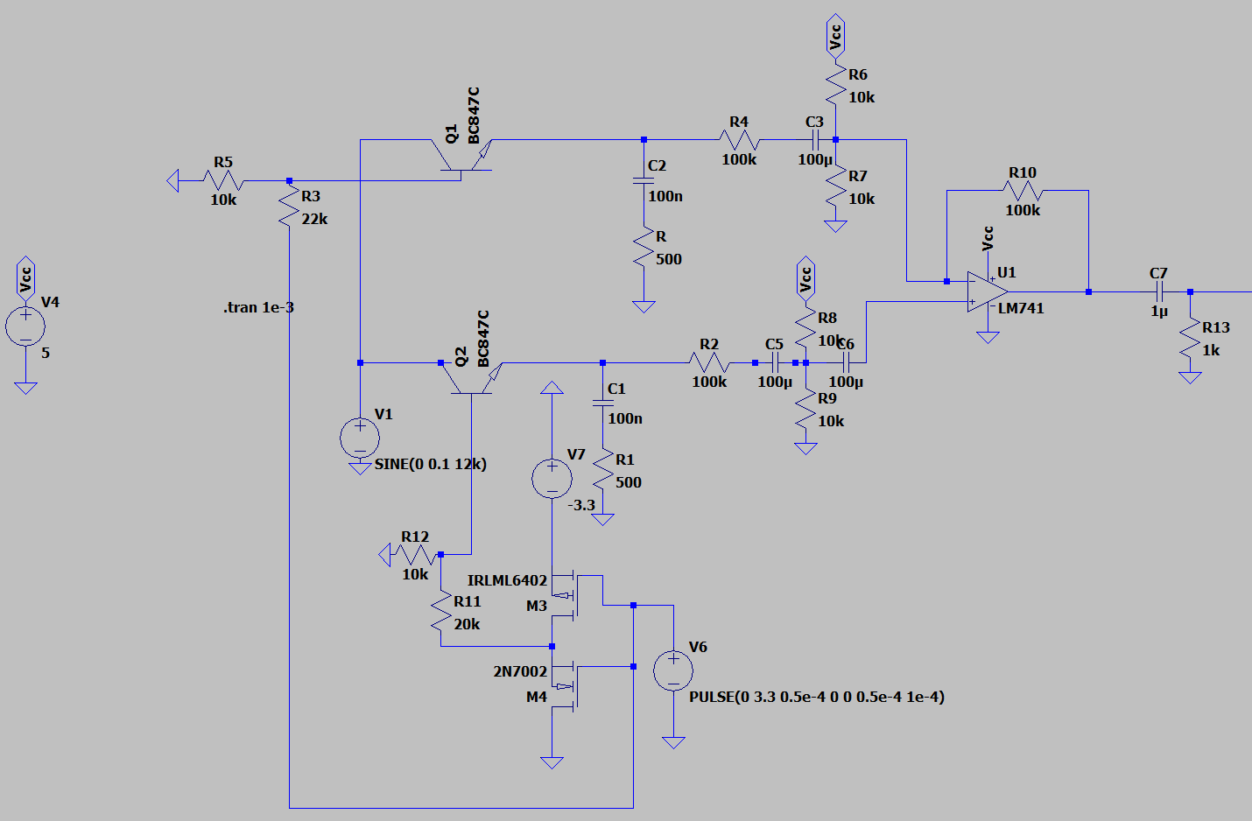
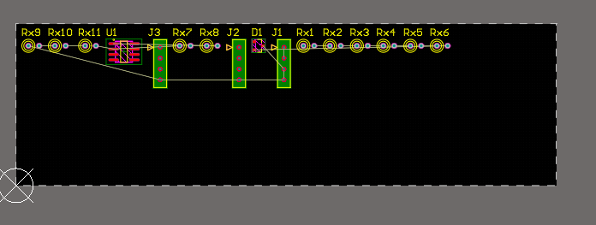
HFA3101 IC Mixer
Provides more space on the PCB.
Minimal information available for low-frequency applications.
Will require in-depth breadboard testing to verify performance.
Presenter: Michael Z

Slide 7
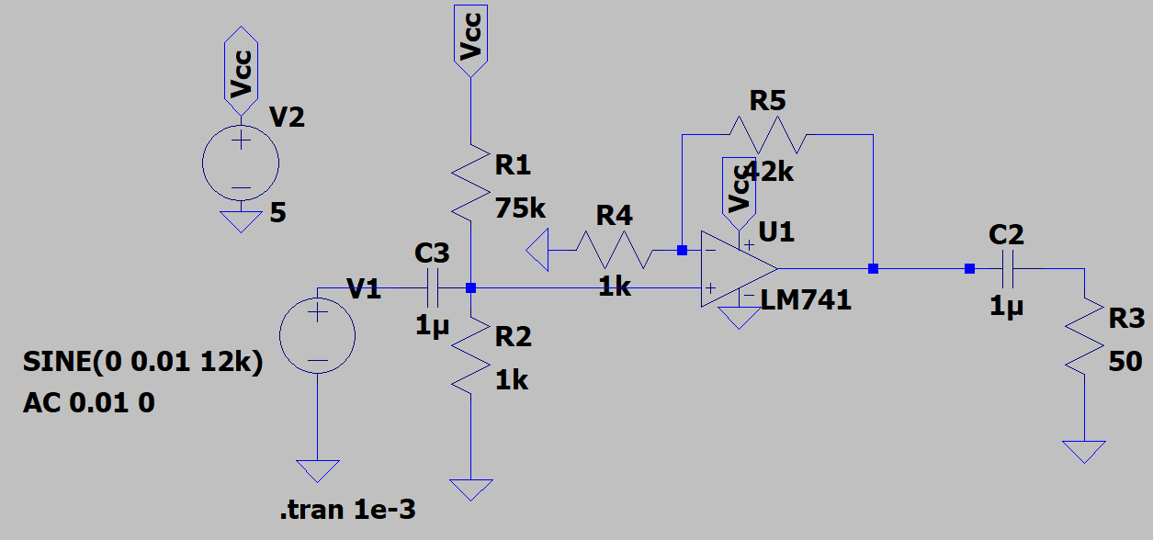
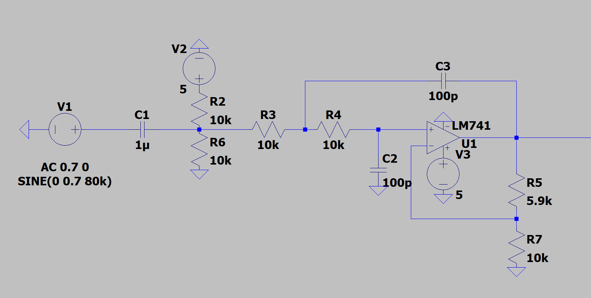
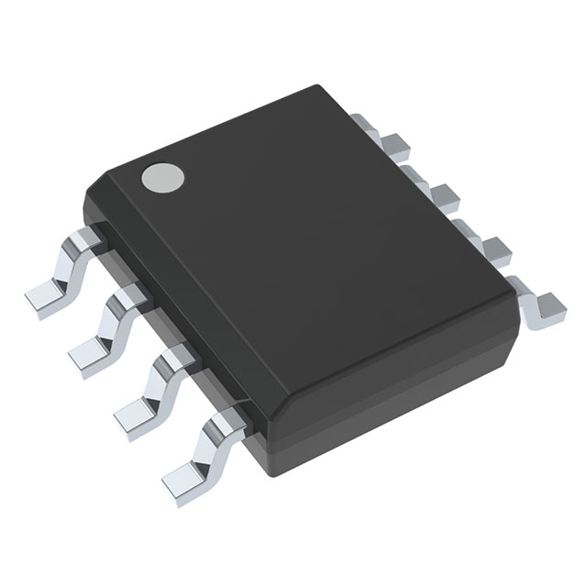
We utilized active components in our I/Q amplifier and LPF.
Utilized the LM4562 op-amp post mixing for both the I/Q amplifier and low-pass filter.
Will perform better than the simulated LM741 op-amp at higher frequencies.
Presenter: Harish B

Slide 8
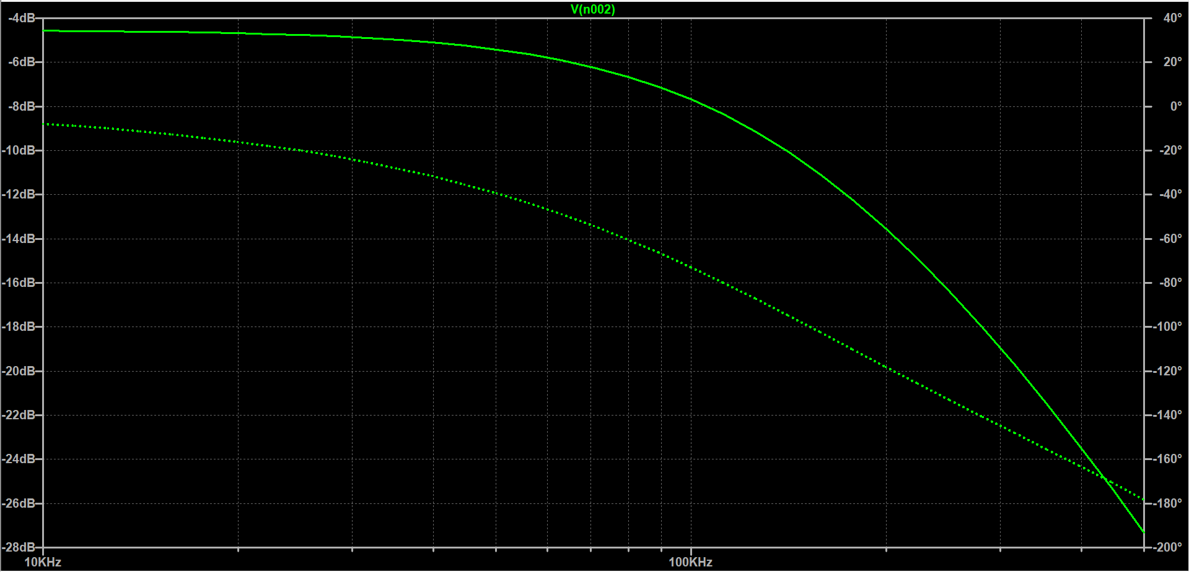
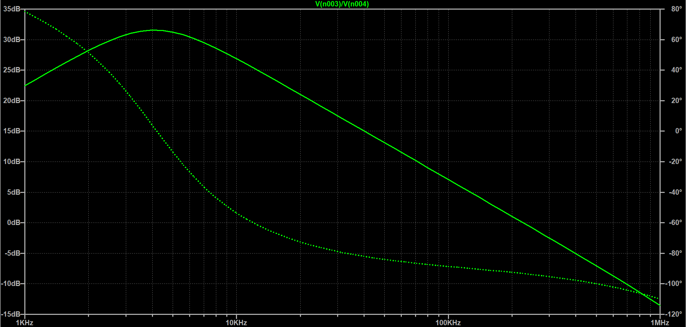
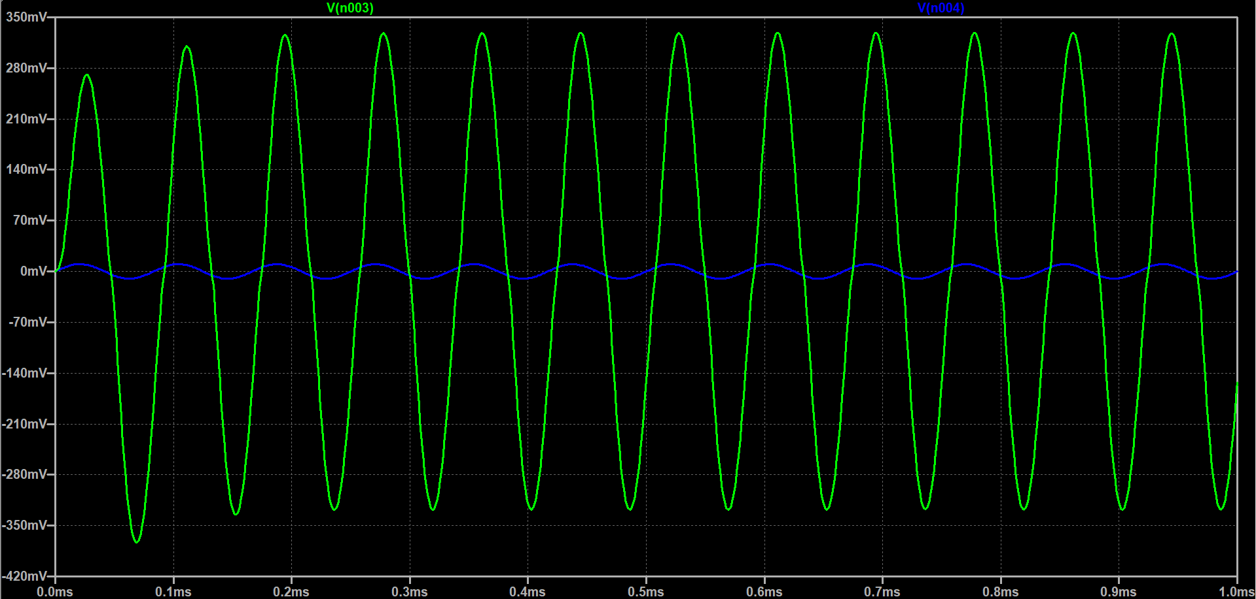
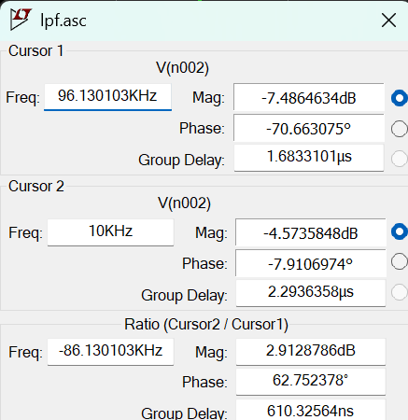
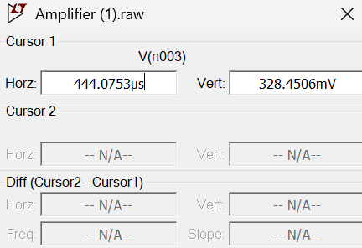
Through simulation, the design was confirmed to meet the minimum constraints.
System | Constraint(s)
RX Bandpass Filter | - Must pass 8-16 MHz frequency bandwidth - 3 dB cutoff frequencies must be at 8 and 16 MHz
Limiter | - Maximum of ± 0.7 V is passed, any excess is clipped
Quadrature Mixer | - I and Q signals must be 90°±12.5° apart in phase, with Q lagging I - Amplitude difference must be within 1 dB - Outputs must not exceed 0 - 5 V
I/Q Amplifier | - Minimum of 30 dB gain applied to the I and Q signals
Low-pass Filter | - At least first order filtering with an upper cutoff frequency of 96 kHz
Presenter: Harish B

Slide 9
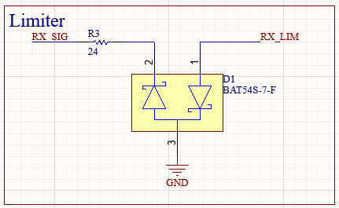
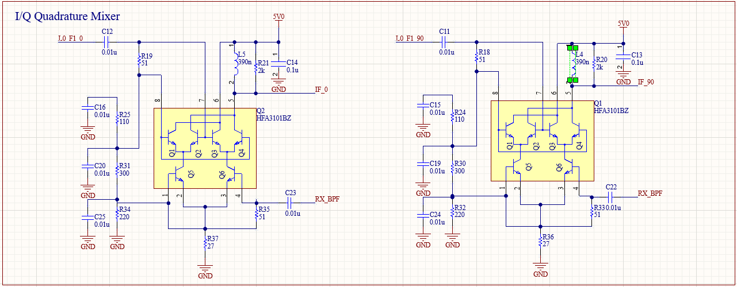
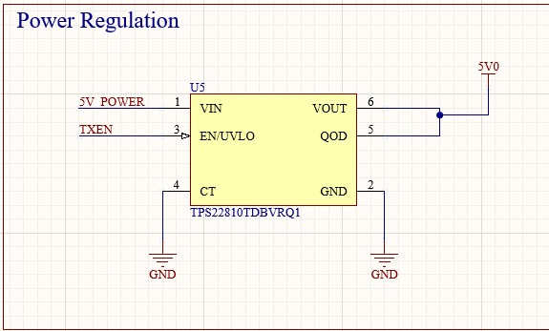
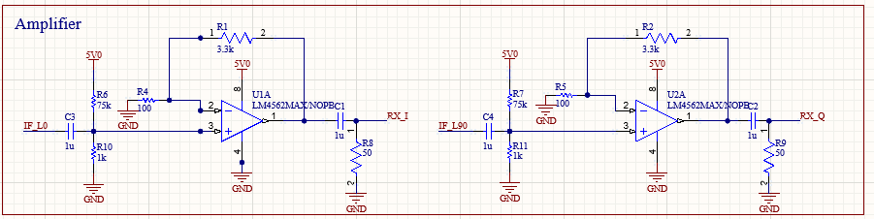
Input/Output Description
Input/Output | Description
Input 1: Unfiltered RX signal Limiter | - High Frequency (HF) radio band (Antenna): 3 - 30 MHz
Input 2 & 3: Local oscillator (LO) signals Quadrature Mixer | - Oscillator signals (Subsystem C): 90° phase difference
Input 3: Active-low transmit-enable signal Power Regulator | - Active-low Enable (Subsystem C): 0 = Receiving, 1 = Transmitting
Output 1 & 2: In-phase (I) and quadrature (Q) signals I/Q Amplifier | - Mixed I and Q signals: 96kHz frequency cut, >30db gain
Power signal | - 3.3V/5V from the DC power supply to power active components.
Presenter: Ryan N

Slide 10
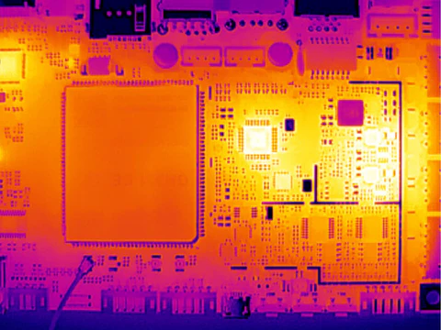
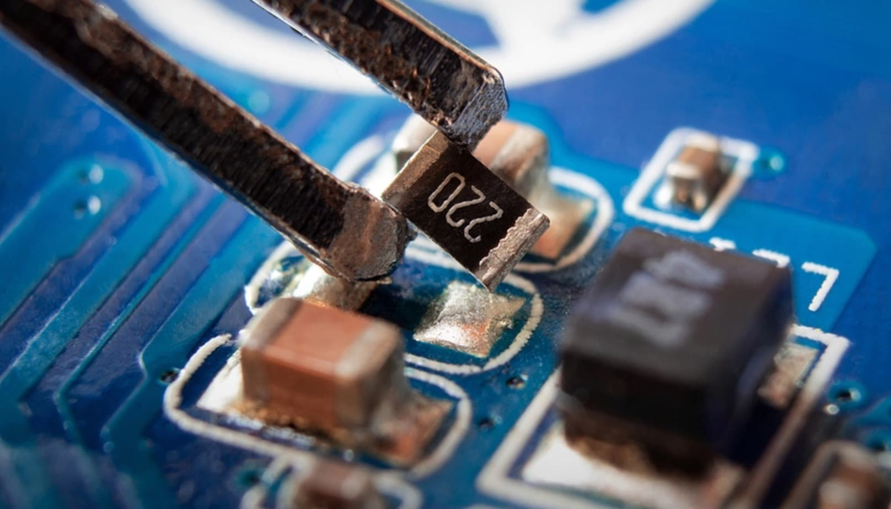
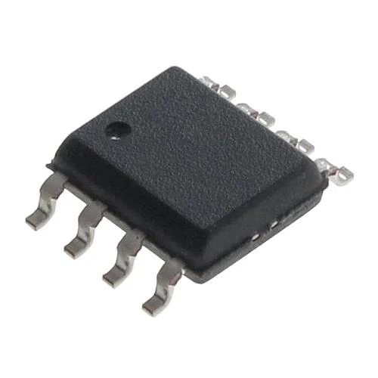
We expect to encounter various challenges during testing and assembly.
Presenter: Ryan N, Michael Z, Harish B

Slide 11
Our design passes simulations and awaits physical construction and testing.
Feb. 22
Feb. 24
Mar. 9
Mar. 17
Apr. 7
Designs completed
Simulations passed
Parts ordered
Breadboard prototyping completed
PCB Ordered
PCB assembly
Final testing
Integration with FLRTRX
Final presentation preparation
Presenter: Michael Z

Slide 12
Q&A

Slide 13
References
University of Toronto: ECE295, Flexible Radio Transceiver (FLTRX) Interface Control Document (2025). Accessed: Feb 22, 2025. [Online]. Available: https://q.utoronto.ca/courses/376071/files/35564251?module_item_id=6329605.
University of Toronto: ECE295, Focused Design Lab 1: Subsystem A. Accessed: Feb 22, 2025. [Online]. Available: https://q.utoronto.ca/courses/386381/files/35898238?module_item_id=6520144.
“HFA3101BZ”, Mouser. Accessed: Feb 22, 2025. [Online]. Available: https://www.mouser.ca/ProductDetail/Renesas-Intersil/HFA3101BZ?qs=cbl4%252BYHJGOFDjSseBp6eUA%3D%3D&srsltid=AfmBOorSTW-J2GjsmD1Tt8yPUNOdcrWq04V2mOR_Tr-Yc2dE8p4mVr_a.
“Smd Blue Stock Photos, Images & Pictures”, dreamstime. Accessed: Feb 22, 2025. [Online]. Available: https://www.dreamstime.com/photos-images/smd-blue.html?pg=3.
“Thermal Camera Inspires Your PCB Inspection and Repair Efficiency”, infrared. Accessed: Feb 22, 2025. [Online]. Available: https://www.xinfrared.com/ja/blogs/blog/thermal-camera-inspires-your-pcb-inspection-and-repair-efficiency.
“LM4562MAX/NOPB”, DigiKey. Accessed: Feb 22, 2025. [Online]. Available: https://www.digikey.ca/en/products/detail/texas-instruments/LM4562MAX-NOPB/1871613.

